Slide 1
Play Store App Review Analysis EDA Dashboard
File created on: 3/21/2026 8:40:04 AM

Slide 2
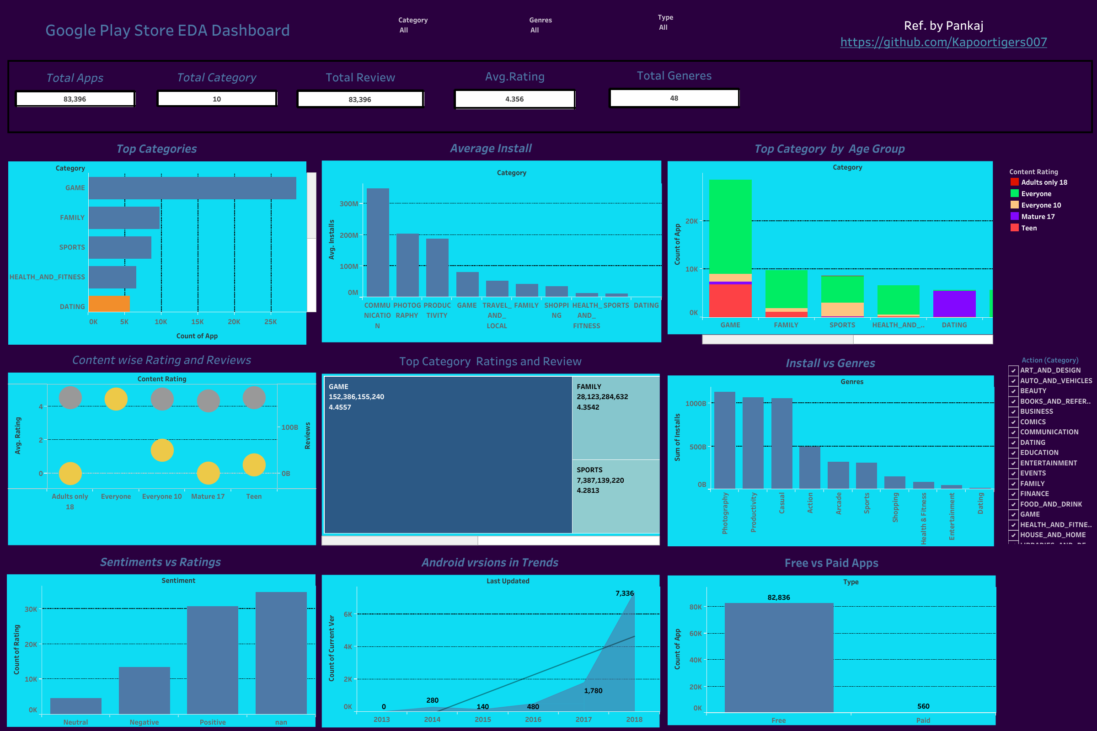

Slide 3


Slide 4


Slide 5


Slide 6


Slide 7


Slide 8


Slide 9
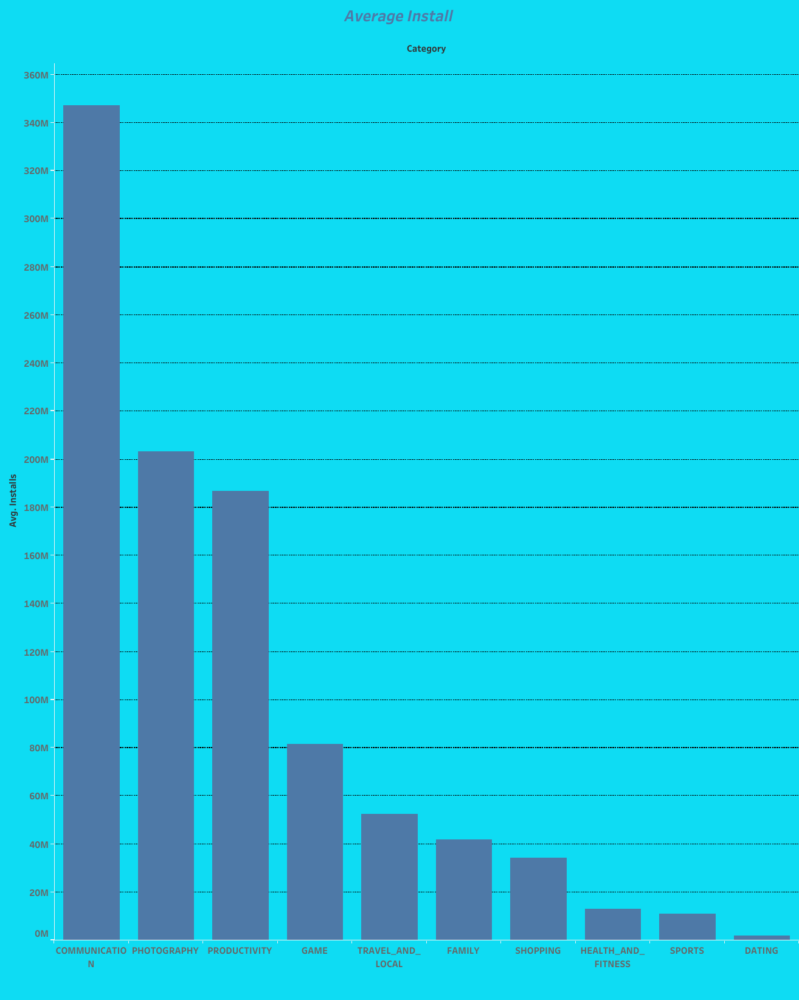

Slide 10
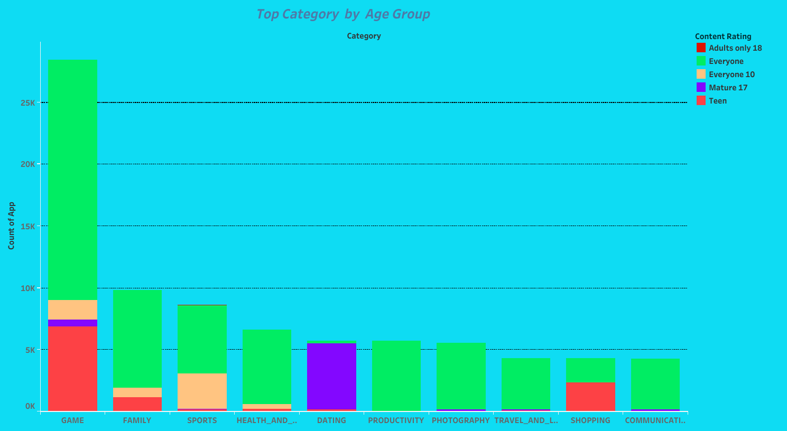

Slide 11
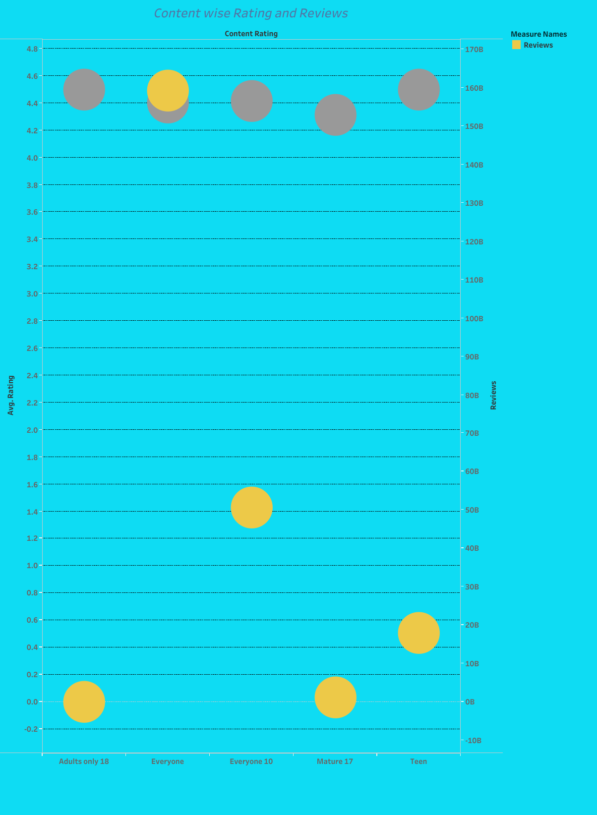

Slide 12
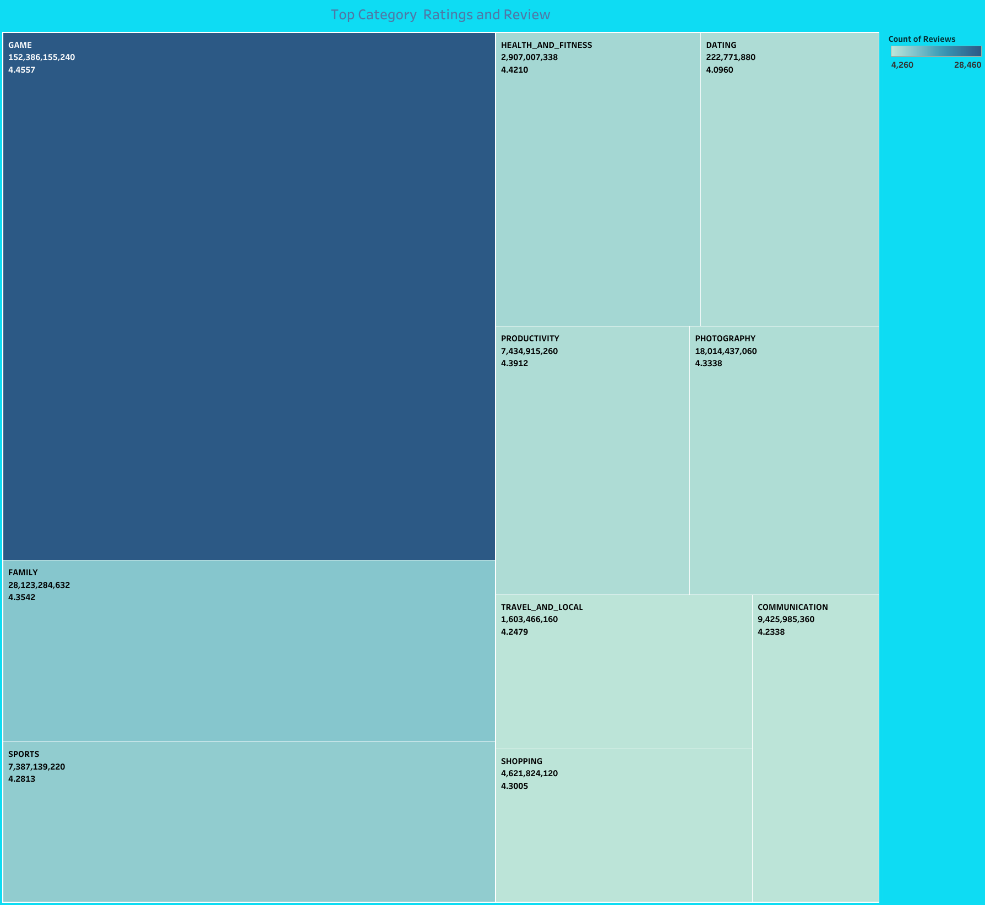

Slide 13
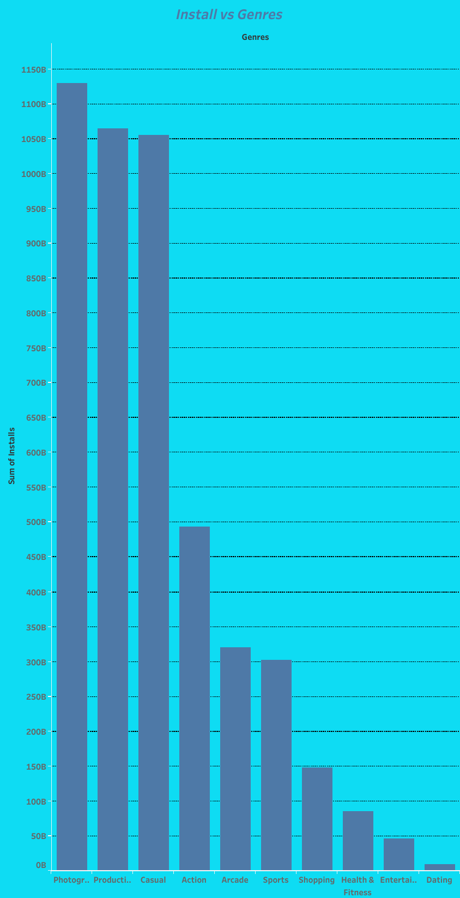

Slide 14


Slide 15
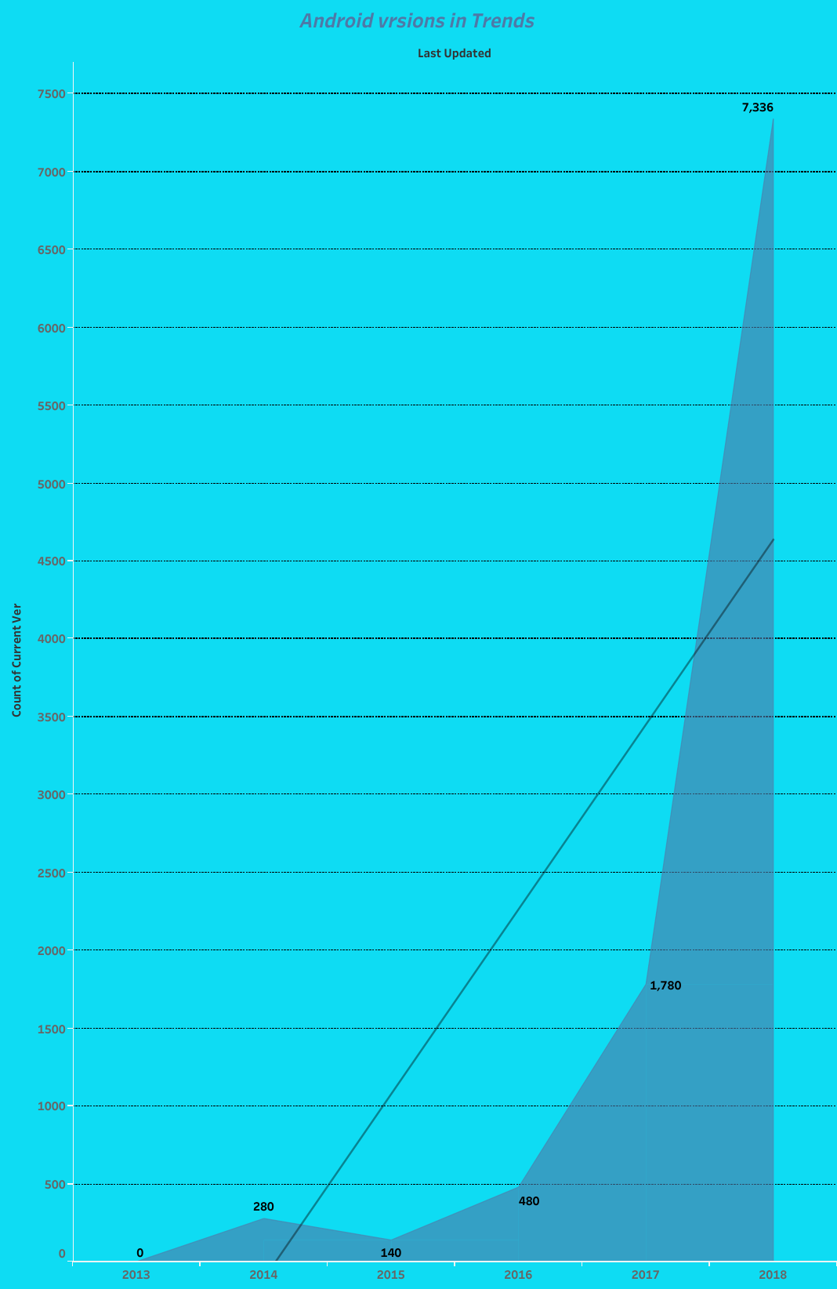

Slide 16


